Slide 1

Post 18 Choices – a guide for Parents
Ben Collie & Jacqui Quinney

Slide 2
Choices available
Higher education
Apprenticeships
Studying abroad
Gap year
Getting a job
Security marking: PUBLIC
05 May 2022
| 2

Slide 3
Apprenticeship advice
Degree Apprenticeships are a valid alternative to full time university – students achieve the same level of qualification whilst also gaining work experience
Full time work and studying at the same time
Salary and no university fees
Very competitive but the number of opportunities is increasing each year
Need to know what type of area you want to work in
Applications are direct to the employer – can be time consuming
Head to: ucas.com/apprenticeships
Security marking: PUBLIC
05 May 2022
| 3

Slide 4
University – a huge choice….
350+ universities and colleges:
  4 in Northern Ireland
  15 in Wales
  18 in Scotland
  316 in England
35,000+ courses available
Security marking: PUBLIC
05 May 2022
| 4

Slide 5
Why higher education?
Opportunities while studying:
Chance to study a subject they are passionate about.
Achieve a qualification that could lead to their chosen career.
Grow in confidence, make lifelong friends, and gain independence and important life skills that will widen their prospects.
With a degree, they’ll have:
  the opportunity to follow their career path
  better job prospects, as many employers target graduates
  higher earning potential
Security marking: PUBLIC
05 May 2022
| 5

Slide 6
Choosing the right university
Style – from the traditional, with a focus on subject-based courses and research, to modern universities, with a greater focus on vocational courses.
Location – some are based in large cities, others in smaller towns - a major influence on the environment and lifestyle.
Size – larger universities can have more than 20,000 students, whereas some of the smallest have only a few thousand.
Culture and facilities – influenced by a range of factors, including the diversity of students who attend.
What graduates do – all universities collect destination statistics. It can be interesting to find out the types of jobs or further study students go on to.
Tuition fees – can vary between course providers. Check if there are any scholarships or bursaries available.
Living costs – accommodation, transport, and food can vary enormously.
Security marking: PUBLIC
05 May 2022
| 6

Slide 7
Choosing the right course
What does the course cover?
Courses with the same title may be very different.
Look carefully at the core course content, and the range of optional studies/modules available.
Which modules are the most interesting and relevant to career aspirations?
See if the course or university/college offers any internship, placement, or study abroad opportunities.
How is the course taught – structured teaching, or more independent research? How many lectures are there, and how much group work will be done in seminars?
How is the course assessed?
Security marking: PUBLIC
05 May 2022
| 7

Slide 8
When to apply for 2022 entry
18 May
UCAS Undergraduate Apply opens for 2022 entry.
7 September
First day UCAS can receive a completed application to process
15 October
UCAS Application deadline for courses in medicine, veterinary medicine/science, and dentistry, and courses at Oxford or Cambridge.
26 January
UCAS Equal consideration application deadline.
February
UCAS Extra opens.
End of June
Last date for applications before Clearing opens.
Security marking: PUBLIC
05 May 2022
| 8

Slide 9
Applying - key facts
Register with UCAS via the Hub
Use your username and password to apply online
Students can add up to 5 choices, unless they’re applying to study medicine, veterinary, medicine/science, dentistry – then it’s 4 choices
Students can’t apply to BOTH Oxford and Cambridge
Applying costs £22 for 1 choice, or £26.50 for 5 choices
Apply by the equal consideration date
Providers can’t see other choices when you apply

Slide 10
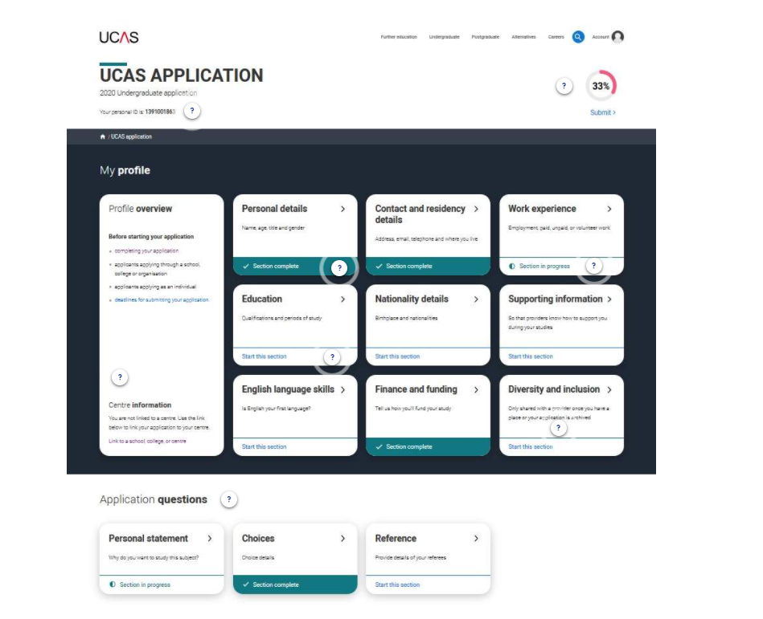
Making an application
Sections to be completed:
Personal details
Contact and residency details
Work experience
Education
Nationality details
English language skills
Supporting information
Personal statement
Choices – make up to five
References
Finance and funding
Diversity and inclusion (for students with a UK home address)
Security marking: PUBLIC
05 May 2022
| 10

Slide 11







The personal statement
The only section students have full control over
Students only chance to market themselves individually
UCAS’ similarity detection service:
every personal statement is run through software to check for plagiarism.
The same for all choices
A maximum of 4,000 characters, or 47 lines
A minimum of 1,000 characters
There isn’t a spelling or grammar check
No formatting is allowed
Security marking: PUBLIC
05 May 2022
| 11

Slide 12
Completing the UCAS application
Students register for a UCAS Hub account
Student complete their application – working their way through all sections and send it to their school/college
Teachers/advisers review the application and add reference and predicted grades
Applications are sent to UCAS by the school on behalf of the student
Universities/colleges make their decisions
Security marking: PUBLIC
05 May 2022
| 12

Slide 13



Decisions
Universities and colleges will review the:
They may also ask for:
personal statement
admissions test
qualifications
interview
reference
portfolio/audition
Security marking: PUBLIC
05 May 2022
| 13

Slide 14

Replies to offers
Once students have decisions from all their choices, they can hold a maximum of two offers:
  one as a ‘firm’ acceptance – their first choice
  the other as an ‘insurance’ acceptance. This acts as a back-up if they don’t get into their ‘firm’ choice
They must then decline any remaining offers.
Once all decisions and replies have been made, if students aren’t holding an offer, they may be able to use Extra or Clearing to find available places.
Security marking: PUBLIC
05 May 2022
| 14

Slide 15

Other options
Extra (Feb – Jul)
  Used all five choices and had no offers.
  Add Extra choices for consideration one at a time in Track.
Clearing (Jul – Oct)
Apply after 30 June, receive no offers, decline all offers, not met conditions.
Find vacancies from early July, and add a Clearing choice to their application.
Security marking: PUBLIC
05 May 2022
| 15

Slide 16

What should students be doing now?
Research on Unifrog.org – they will be shown this next week
Book University Open Days
supercurricular activities – e.g. extra reading, MOOCs
work experience/volunteering – essential for some
focus on this year’s studies – predicted grades are vital
Security marking: PUBLIC
05 May 2022
| 16

Slide 17
How can you support them?
Research
Use the parents/guardians’ section of the UCAS website at www.ucas.com/parents.
Sign up
Sign up for parent updates from UCAS and get everything you need to know about the application process direct to your inbox.
Open days
Attend virtual events and open days with your young person – you may have a different perspective.
Be proactive
Make sure they read everything carefully that is sent to them and don’t book holidays at key times!
Security marking: PUBLIC
05 May 2022
| 17

